Slide 1

DEVELOPING AN INTELLIGENT TRANSPORT SYSTEM USING SENSORS AND CAMERAS
SUB-TOPIC : SMART VEHICLE DETECTION AND CLASSIFICATION FOR REAL-TIME TRAFFIC MANAGEMENT USING ADVANCED AI MODELS
UNDER THE GUIDANCE OF
PROF. BRIND KUMAR
Department of Civil Engineering
INDIAN INSTITUTE OF TECHNOLOGY
(BANARAS HINDU UNIVERSITY)
VARANASI – 221 005

Slide 2
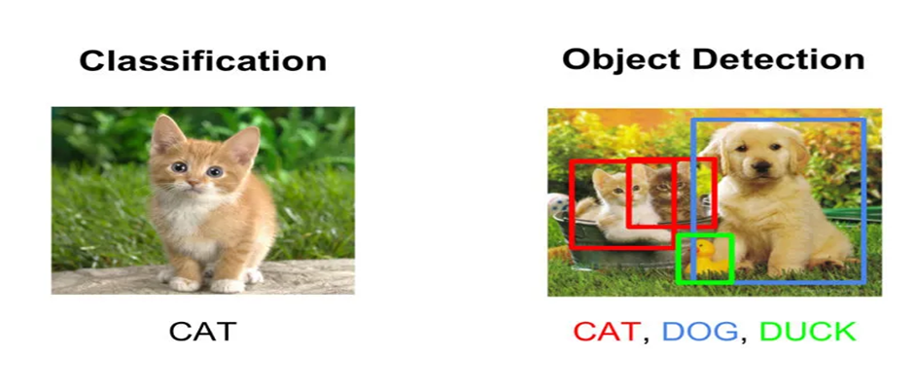
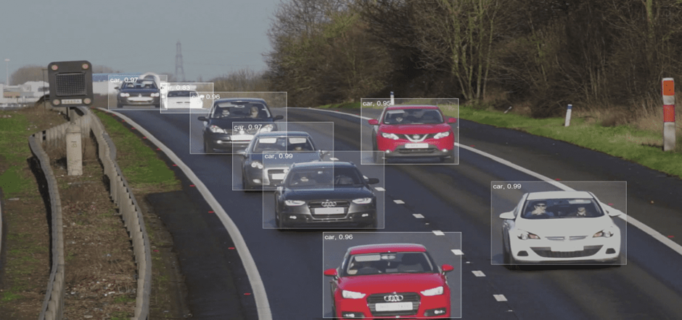
Brief on Object Detection and its relevance in traffic management
1.Definition & Purpose
Object detection is a computer vision technology that identifies and locates objects in images/videos using bounding boxes.
2.Applications
Healthcare: Diagnostics
Autonomous Driving: Self-driving navigation
Retail: Inventory tracking
Manufacturing: Quality control
Security: Crowd monitoring
Agriculture: Crop health assessment
3.Optimization for Edge Devices
Edge Impulse.
Example: FOMO Algorithm by Edge Impulse

Slide 3
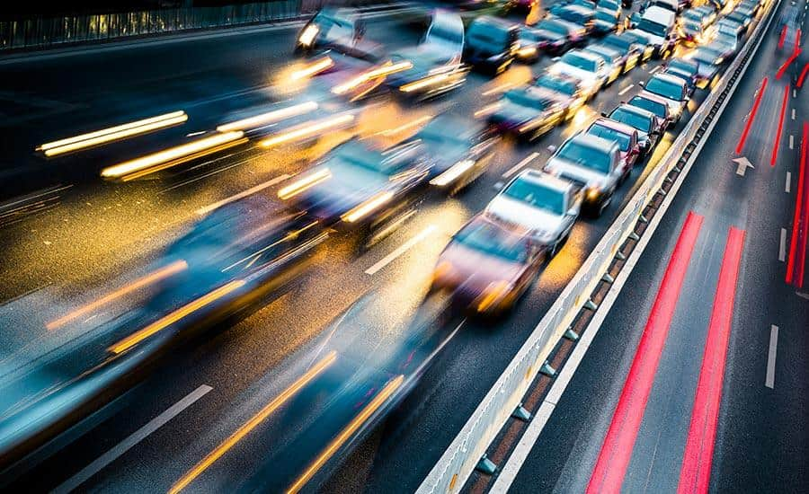
Challenges in Traffic Management:
1. Real-Time Vehicle Detection and Classification
2.Speed Monitoring and Violation Detection
3.Automatic Number Plate Recognition (ANPR)
4.Lane Discipline and Driving Behavior
Monitoring
5.Traffic Flow Prediction and Management
6.Integration with Autonomous Vehicles

Slide 4
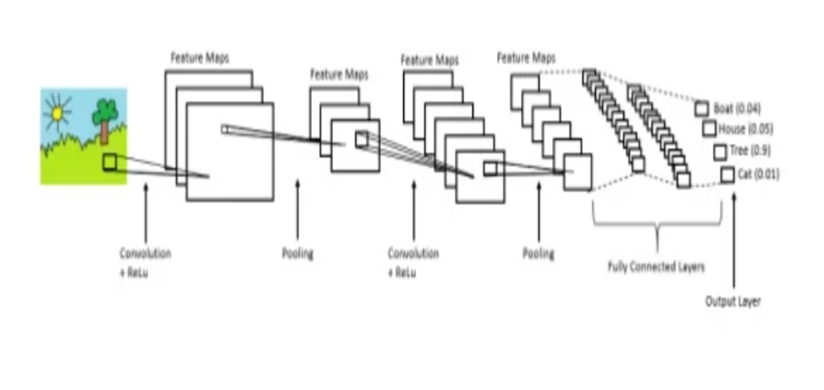
Architecture
We specifically used FOMO, which is Faster Objects, More Objects and YOLO, which means You Only Look Once, when deploying our model.
The reason why we used FOMO as well as YOLO was that FOMO will effectively process images with different sizes of the same object; hence the corresponding reason in YOLO is the effectiveness of real-time object detection speed.

Slide 5
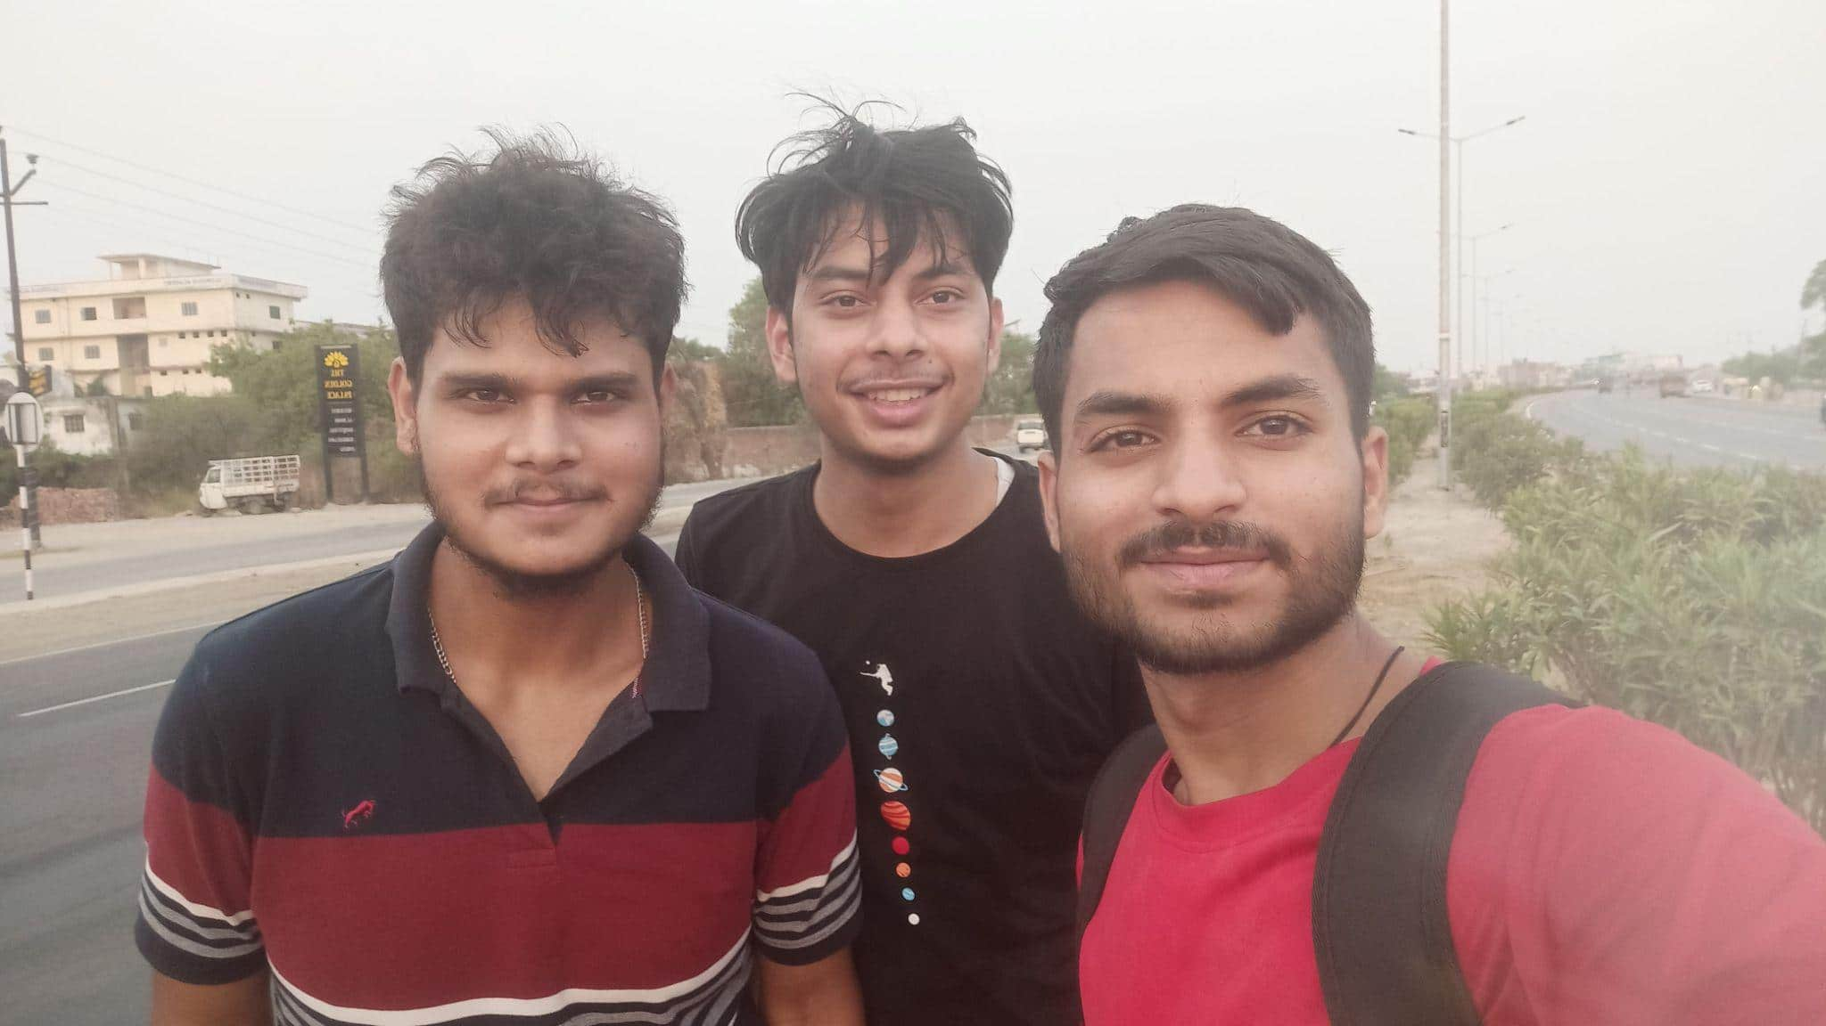
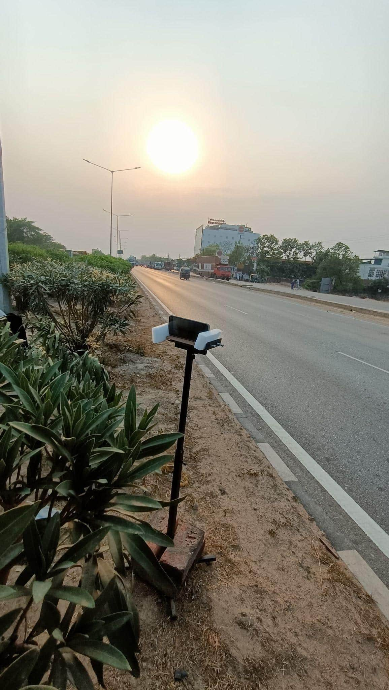
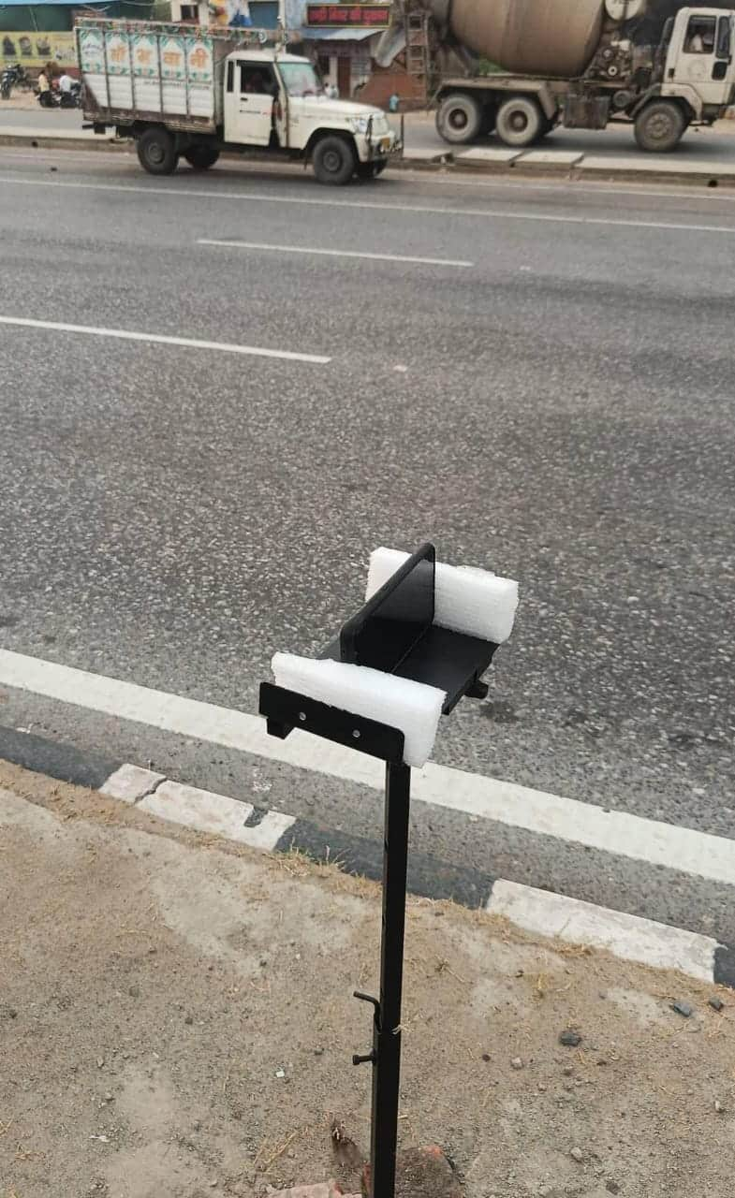
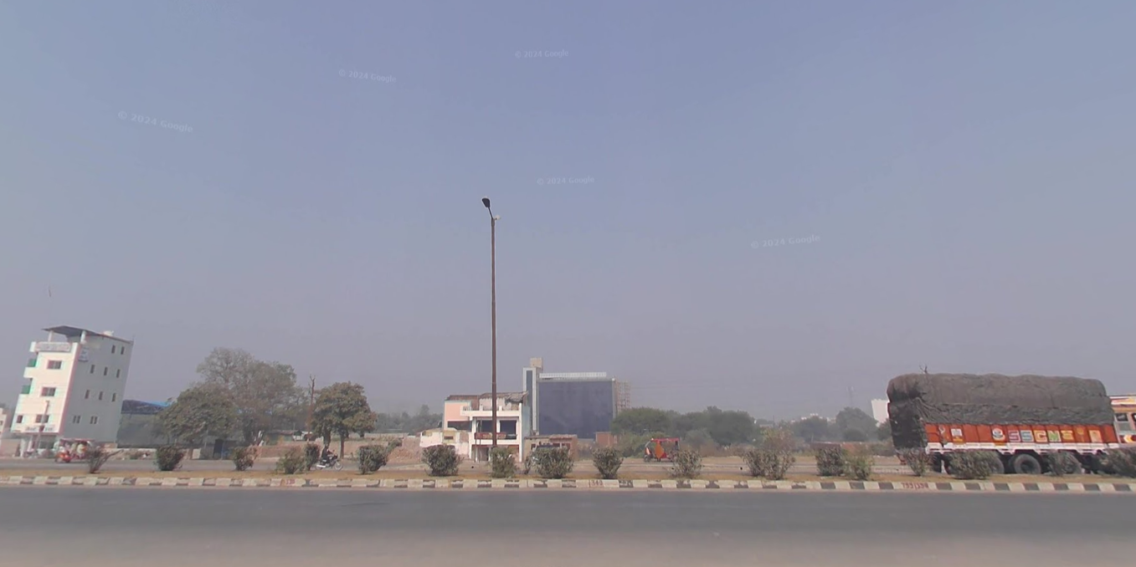
Data Acquisition
Location | NH19, Varanasi
Data Type: | 20-20 minute videos 3hrs in total); 6 lane road
Focussed Classes | Truck, Auto, Car, Bike

Slide 6
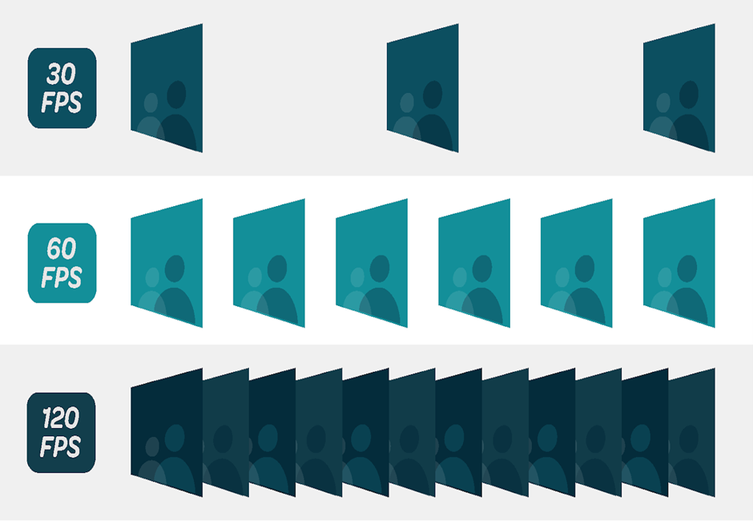
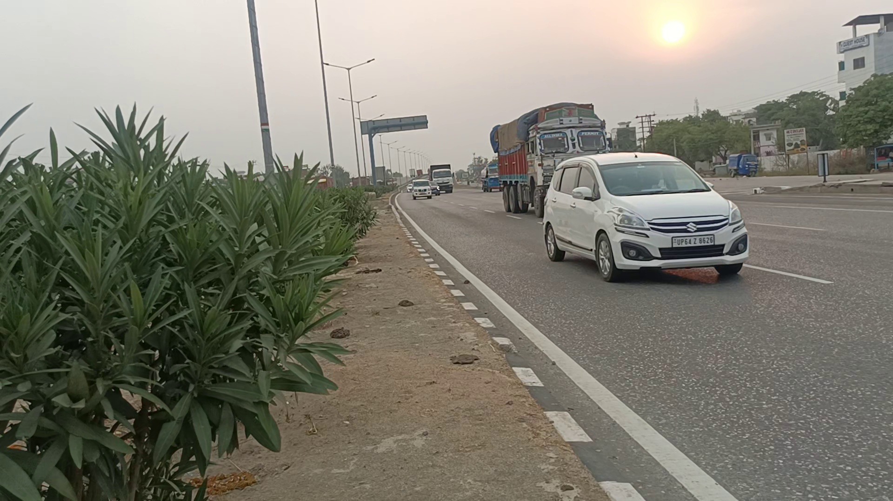
Methodology - Frame Extraction:
FOR TRAINING SAMPLES :
we need to extract frames from the video so we can annotate the objects (classes) within each frame.
A video is like a flipbook made of individual images (frames) that, when shown in quick succession, bring scenes to life by creating the illusion of movement. Each frame changes just a bit to flow smoothly from one to the next.

Slide 7
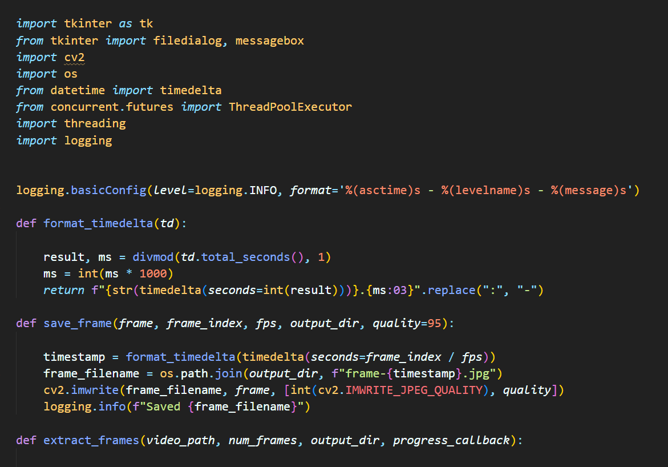
WORKFLOW FOR MAKING A VIDEO FRAME EXTRACTOR:
tkinter: For building the graphical user interface (GUI), allowing users to interactively select the video file, specify output settings, and start the extraction process.
cv2 (OpenCV): For handling video processing tasks, such as reading video frames, navigating to specific frames, and saving frames as images.
os: For handling file and directory operations, like saving extracted frames in the specified output directory.
datetime.timedelta: For calculating and formatting timestamps for each frame, making it easier to organize frames by time.
ThreadPoolExecutor (from concurrent.futures): For enabling multithreading, allowing multiple frames to be saved in parallel, which improves the tool's efficiency.
threading: For creating a separate thread to run the frame extraction process, keeping the GUI responsive during extraction.
logging: For tracking the extraction process and recording useful debugging information, like frame saving status and errors.

Slide 8
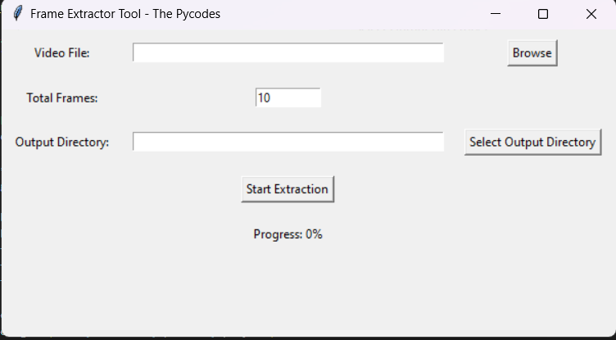
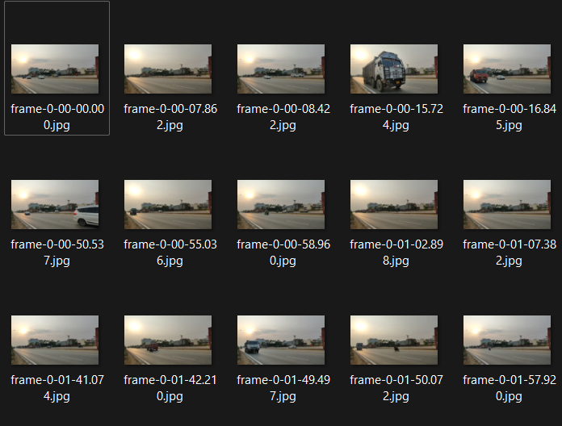
Methodology - Frame Extraction:
GUI Components:
Frames Saved to Directory:

Slide 9
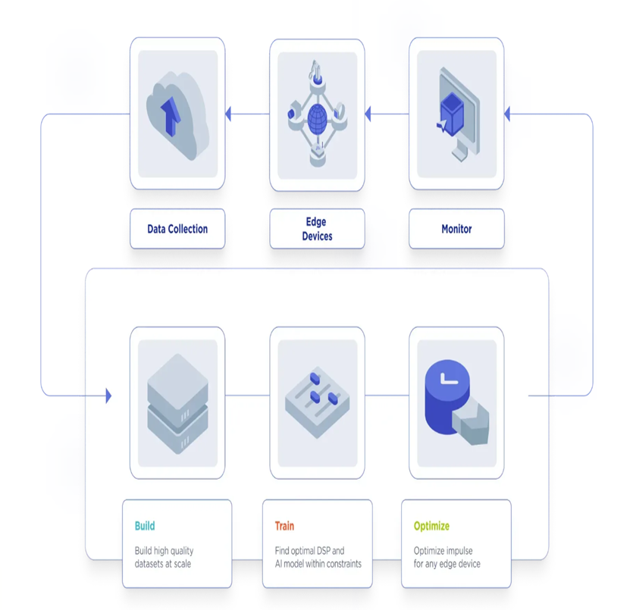

Objectives: Classify and detect vehicles in real-time
Edge Impulse is a development platform that simplifies the process of training, deploying, and managing machine learning models for edge devices.
Helps in:
1.Data Collection
2.Data Processing and Labeling
3.Model Training
4.Optimization and Testing
5.Deployment:

Slide 10
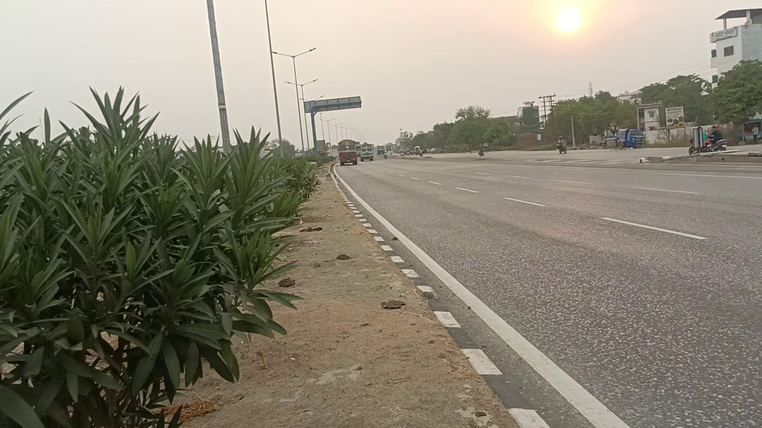
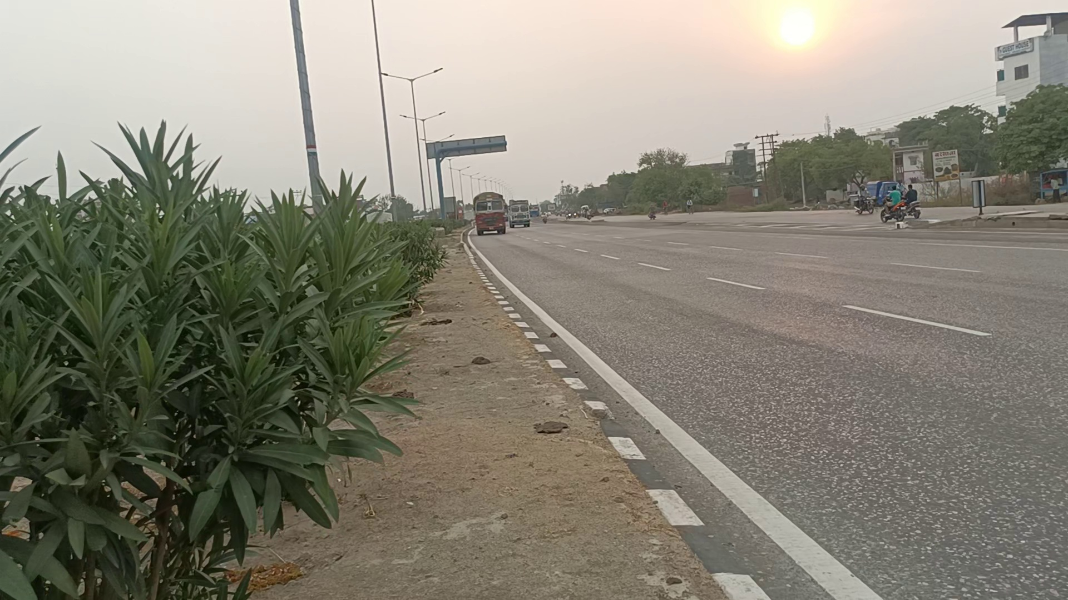
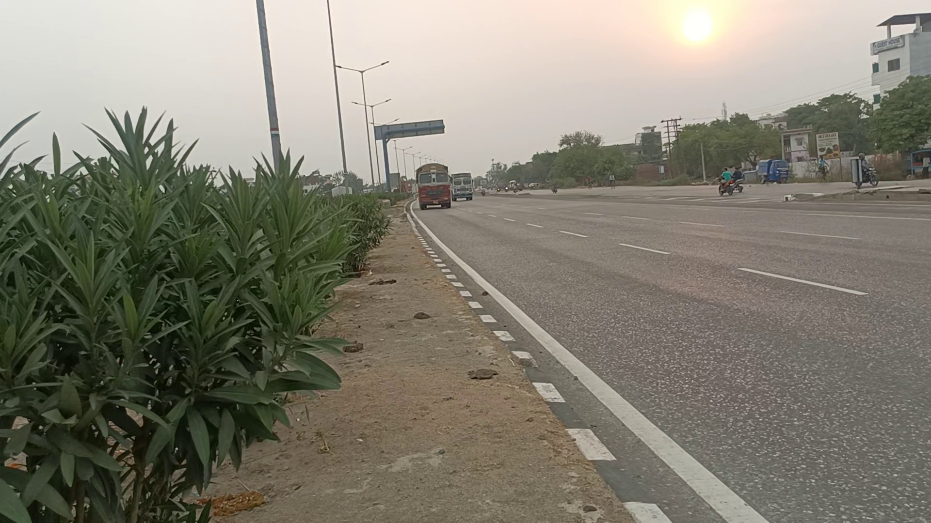
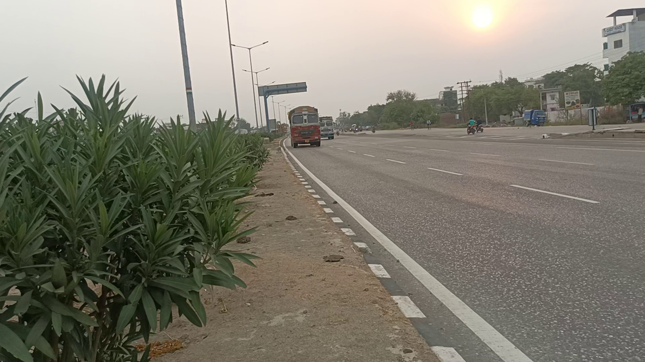
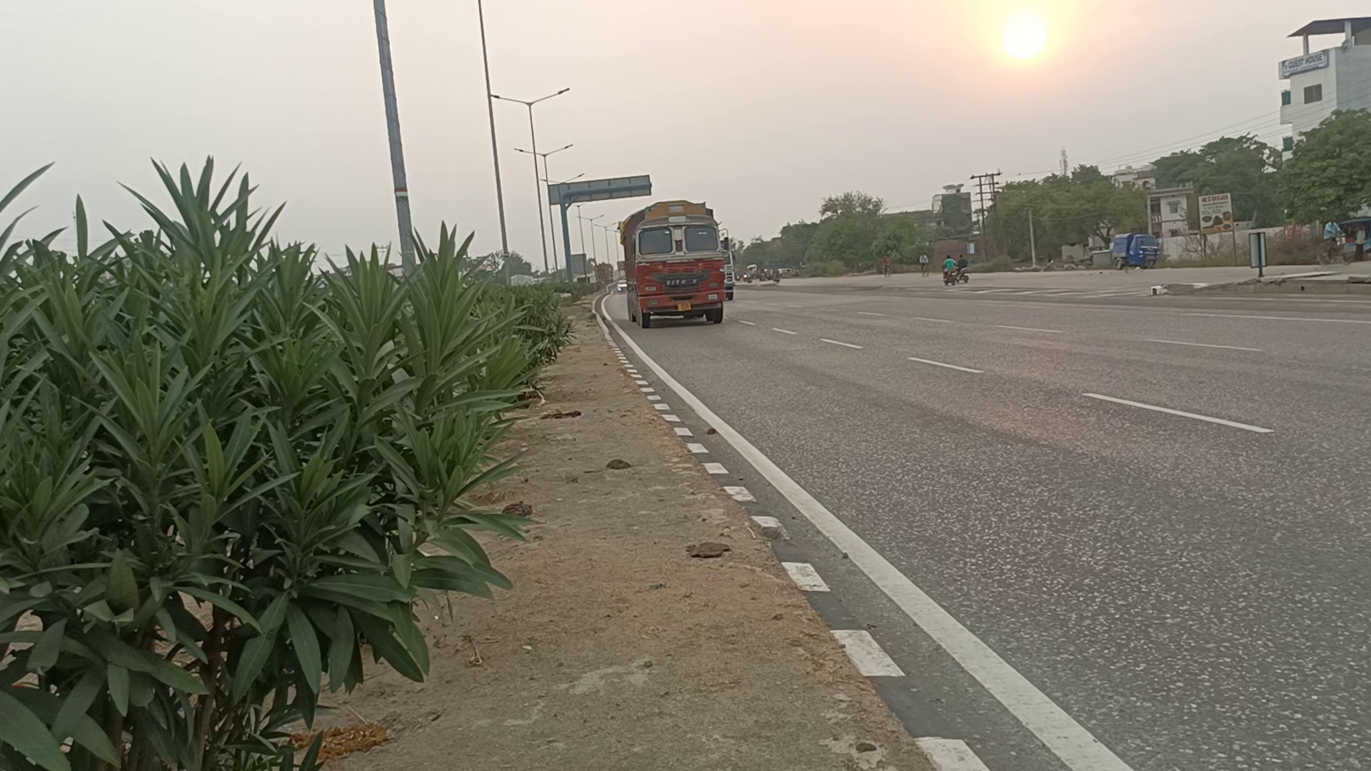
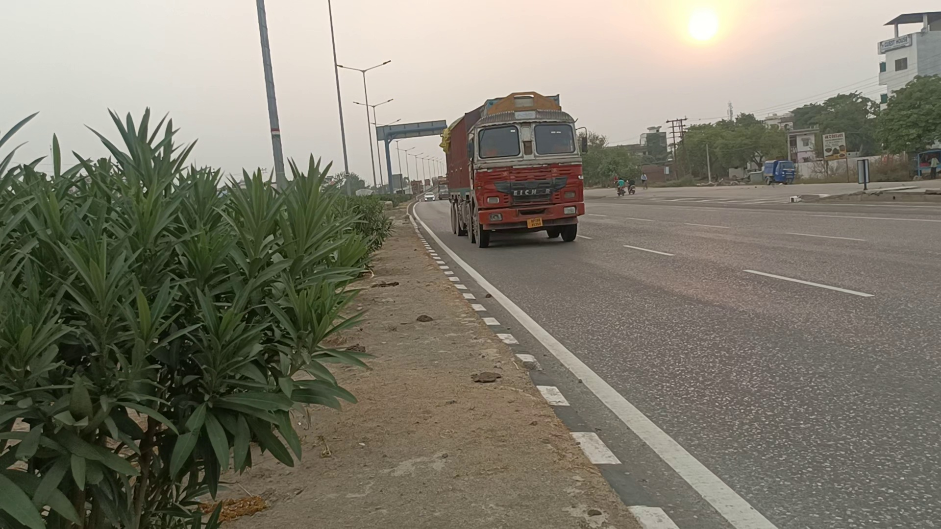
Data Redundancy:

Slide 11
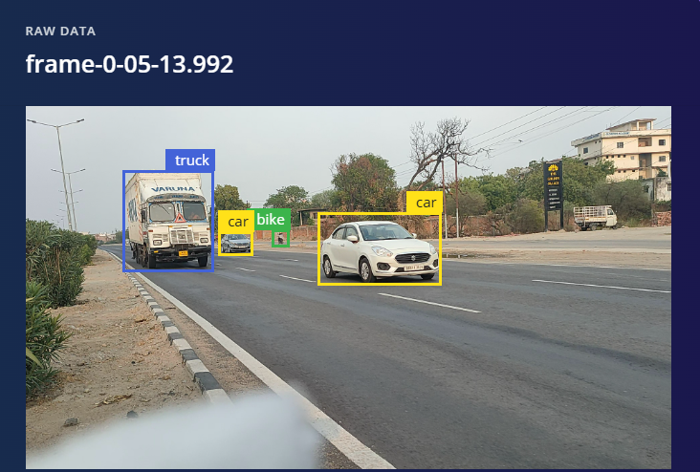
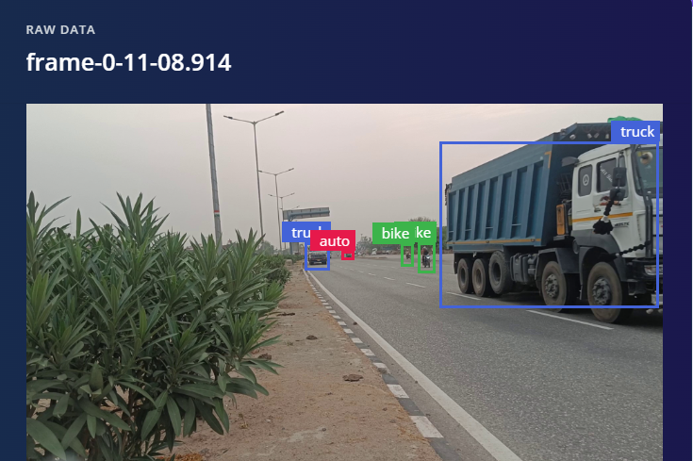
Labeling and Annotation
After extracting roughly 1100 frames, the manual annotation of each frame with the correct class should be done.
This can be achieved by identification of objects of interest in each image such as truck, auto, car, or bike and marking them by putting bounding boxes around the respective objects.

Slide 12
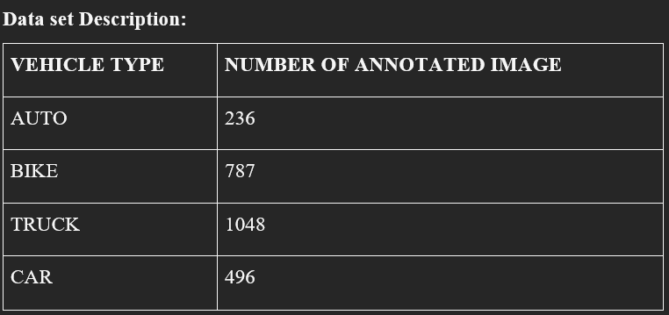
FOMO-Akida Model: Focus on Efficient Object Detection: Integration with Akida Architecture: Edge and IoT Applications: Reduced Resource Consumption: | FOMO-MobileNet v0.35 Lightweight Version of MobileNet: Efficient Computation: Ideal for Embedded Systems: Integration with FOMO:

Slide 13
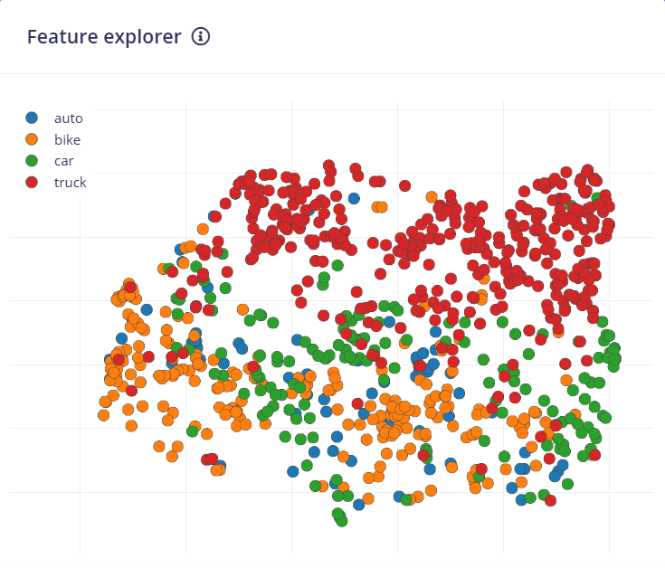
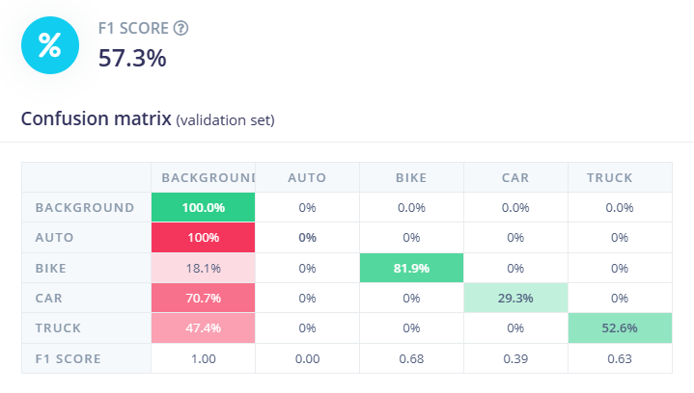
RESULTS AND DISCUSSIONS
RGB- Image Scale
Features Generated

Slide 14
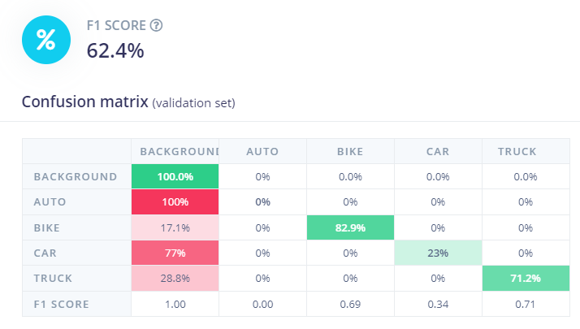
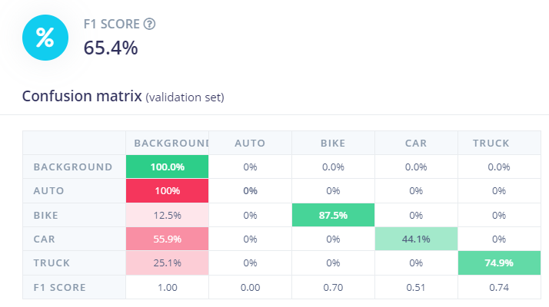
MODEL- FOMO MOBILENET V2 0.35
Epoch-50
Epoch-100

Slide 15
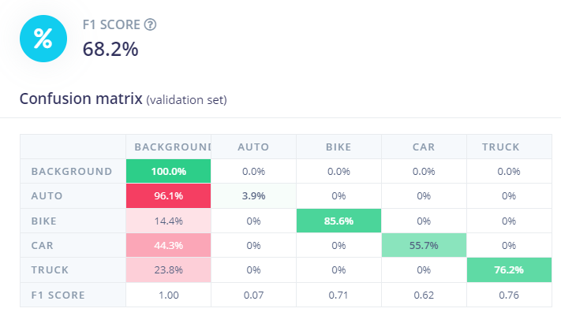
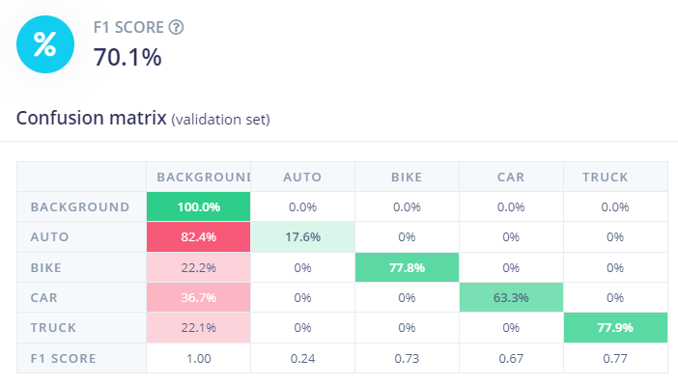
MODEL- FOMO
MOBILENET V2 0.35
Epoch-150
Epoch-200

Slide 16
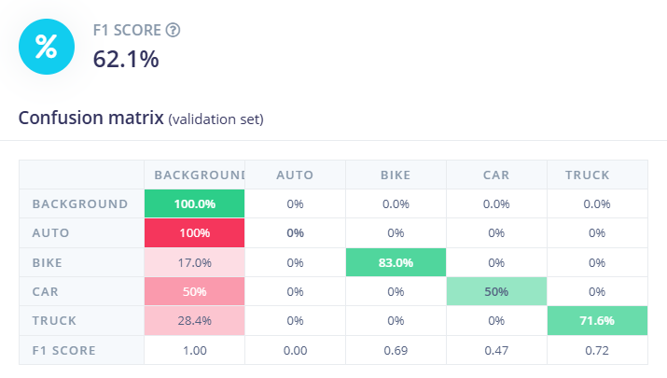
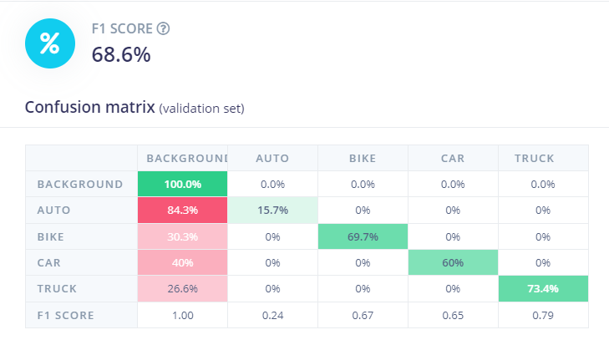
MODEL- AKIDA FOMO
Epoch-50
Epoch- 100

Slide 17
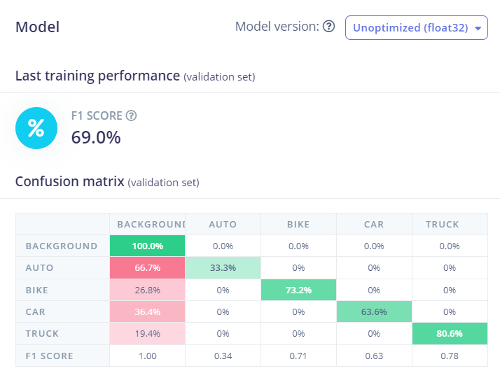
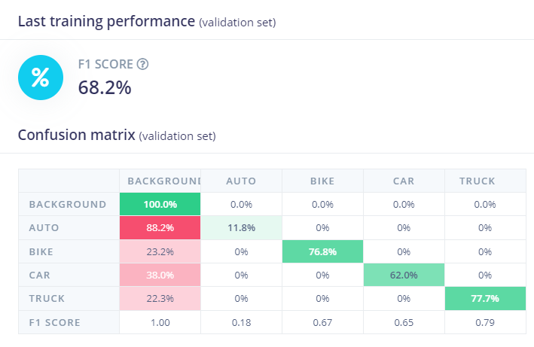
MODEL - AKIDA FOMO
Epoch- 150
Epoch-200

Slide 18
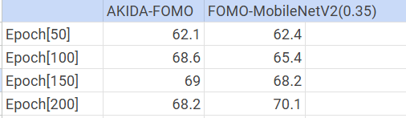
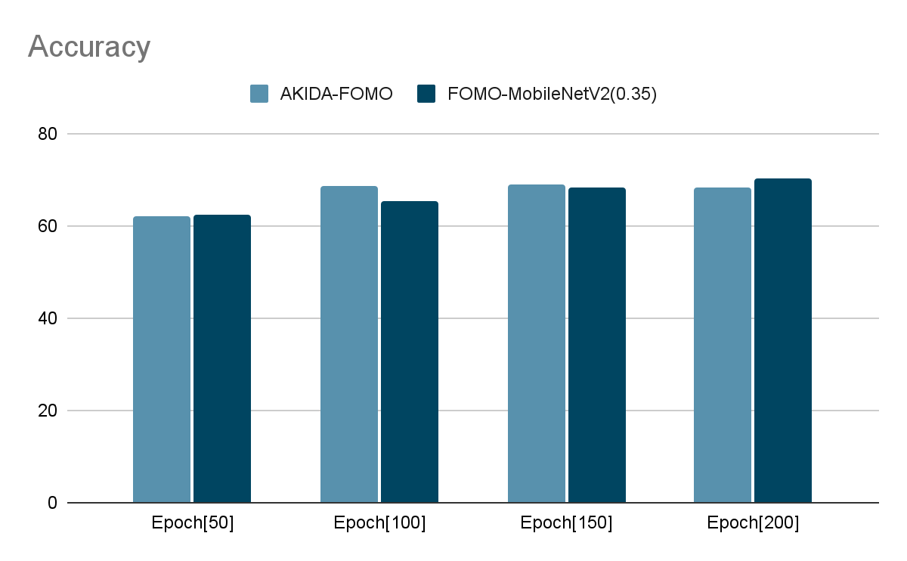
F1 score chart

Slide 19
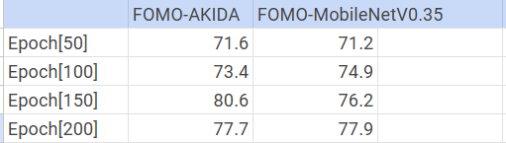
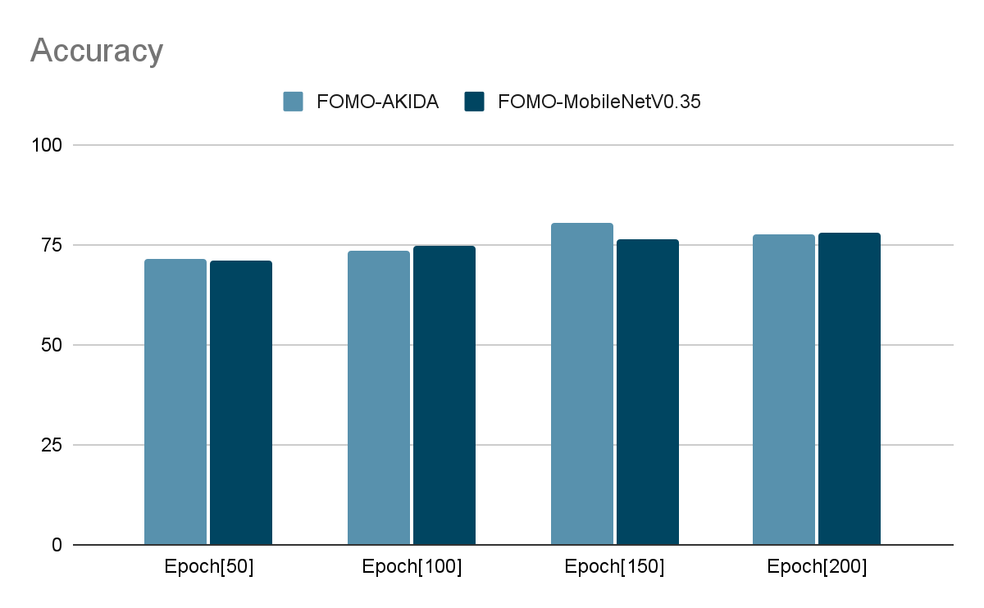
Heavy Vehicle Classification Score

Slide 20
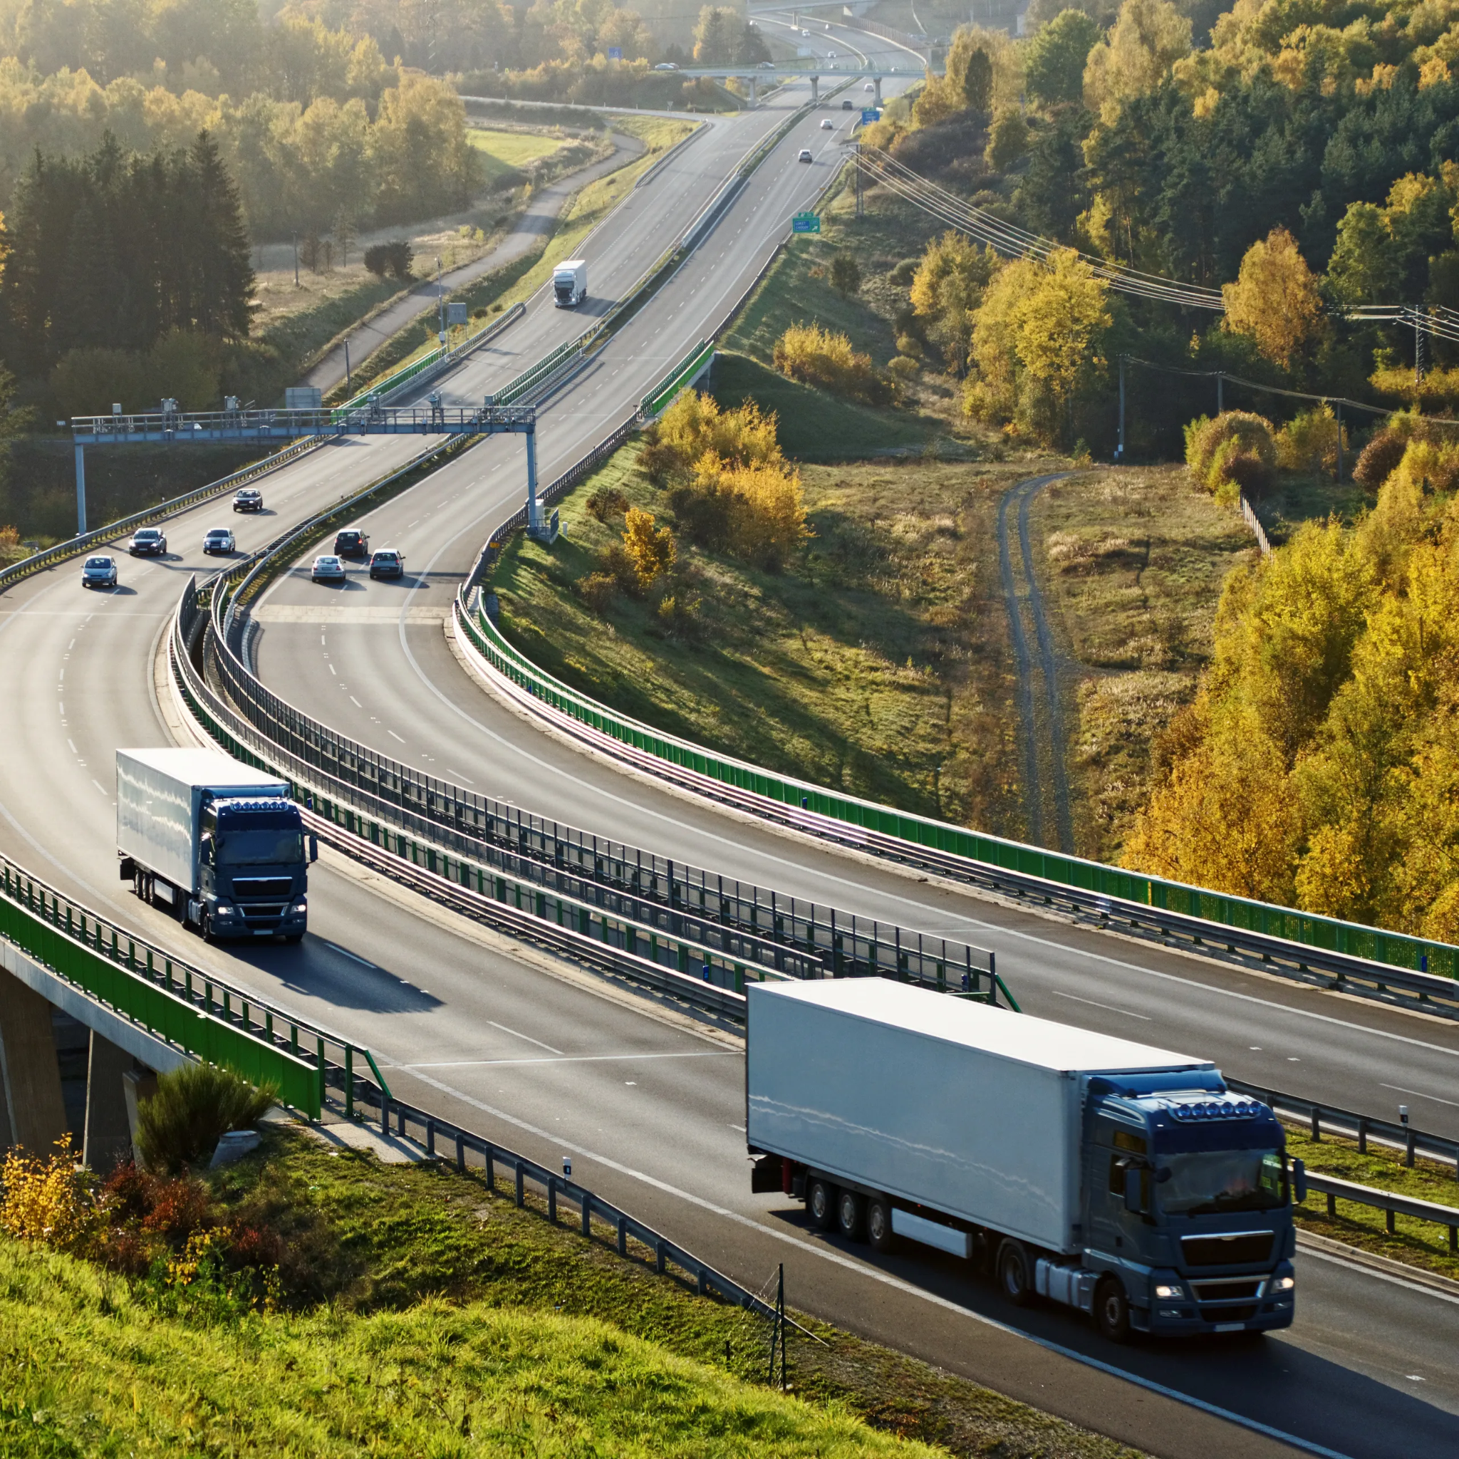
FUTURE WORKS
Future Applications:
Export Model to Sensors: Deploy on various sensors to gather real-time data for on-ground applications.
Highway Design Optimization: Use insights to inform road design and expansion.
Overspeeding & Lane Detection: Enable tracking of overspeeding vehicles and detect lane violations to enhance road safety.
Impact on Infrastructure:
Aids in traffic volume analysis and design planning, contributing to smarter, safer highway management.

Slide 21
THANK YOU
PRESENTED BY:
Abhishek Raj: 21065004
Adarsh Raj: 21065005
Akhilesh Kumar Meena: 21065008

